Slide 1
Learning Methods in Artificial Intelligence
Statistical, Rote, Advice-based, Problem-solving, and Example-based Learning
Dr. Prasenjit Dey
Assistant Professor,
NIT Rourkela,
Odisha, India
deyp@nitrkl.ac.in
9123363688/9674031771

Slide 2
Lecture Agenda
Part 1: Foundations of Machine Learning
  Introduction to Learning in Artificial Intelligence
  Why Learning is Essential for Intelligent Systems
  Overview of Major Learning Paradigms
Part 2: Data-Driven Learning Approaches
  Statistical Learning
  Supervised and Unsupervised Learning Concepts
  Practical Applications and Case Examples
Part 3: Knowledge and Memory Based Learning
  Rote Learning
  Learning by Taking Advice
  Real-World System Demonstrations
Part 4: Experience and Reasoning Based Learning
  Learning in Problem Solving
  Learning from Examples (Inductive Learning)
  Explanation-Based Learning
Part 5: Integration and Applications
  Comparison of Learning Methods
  Real-World AI System Case Studies
  Discussion and Classroom Activity

Slide 3
What is Learning?
Learning is the process by which an AI system improves its performance on a task through experience
In AI, learning means modifying internal models, rules, or parameters based on data or feedback
A learning system is able to
  Adapt to new situations
  Improve accuracy over time
  Generalize from past experience to unseen cases
Learning is a core requirement for building intelligent and autonomous systems

Slide 4
Why Do We Need Learning in AI?
Real-world problems are complex, dynamic, and uncertain
Writing fixed rules for every situation is not scalable
Learning allows AI systems to
  Adapt to new and unseen situations
  Improve performance through experience
  Generalize from past data
  Handle uncertainty and noisy inputs
Learning enables AI to move beyond static rule-based behavior
Rule-Based AI Learning-Based AI
Fixed rules Adaptive model
Manual updates Automatic updates
Fails on new cases Generalizes to new cases
Notes:
Example 1: Face Recognition System
Fixed-rule approach: “If nose width > X and eye distance > Y → Person A”
Fails due to lighting, pose, expression changes
Learning-based approach
Learns complex patterns from thousands of images
Adapts to variations automatically
Example 2: Recommendation Systems (Netflix / Amazon)
User preferences change over time
Learning algorithms adapt recommendations based on recent behavior
Static rules would quickly become outdated

Slide 5
Learning Methods in AI
Artificial Intelligence systems learn in different ways depending on
  Availability of data
  Presence of prior knowledge
  Nature and complexity of the problem.
Major learning methods used in AI:
Statistical Learning
Rote Learning
Learning by Taking Advice
Learning in Problem Solving
Learning from Examples (Inductive Learning)
Explanation-Based Learning

Slide 6
Statistical Learning
Statistical learning is a data-driven learning approach based on probability and statistics
Learns patterns and relationships directly from data
Explicitly models uncertainty and noise present in real-world data
Uses a loss function to measure prediction error
Objective is to generalize well to unseen data, not just fit training data
Common Models / Techniques
  Linear Regression
  Logistic Regression
  Naïve Bayes Classifier
  Bayesian Networks
  Support Vector Machines (SVM)

Slide 7
Supervised Learning
Supervised learning is a learning paradigm where the model is trained using labeled data
Each training example consists of
  Input features x
  Corresponding correct output y (label)
The goal is to learn a function f(x)→y that performs well on unseen data
Learning is guided by a loss function that measures prediction error
Main Types
  Classification – output is a discrete label
  Regression – output is a continuous value

Slide 8
Unsupervised Learning
Unsupervised learning is a learning paradigm where the model is trained using unlabeled data
The system receives only input data xxx, with no correct output labels
Objective is to discover hidden structure or patterns in the data
Focuses on understanding the data distribution rather than prediction
Common Tasks
Clustering
Dimensionality Reduction
Anomaly Detection

Slide 9
Statistical Learning
Training dataset
(x, y)
Statistical Learning Algorithm
Model
Predicting output y for new measurement x
Procedure of statistical learning

Slide 10
Statistical Learning
Advantages
Learns patterns automatically from data
Handles uncertainty and noisy real-world data effectively
Generalizes well to unseen examples when trained properly
Strong mathematical and theoretical foundation
Widely applicable across domains such as text, images, speech, and medical data
Disadvantages
Requires large amounts of data for good performance
Training can be computationally expensive
Performance depends heavily on data quality and feature selection
Many models are hard to interpret (black-box behavior)
Risk of overfitting if not properly regularized

Slide 11
Rote Learning
Rote learning is a learning method where an AI system memorizes information exactly as it is given.
It does not involve reasoning, understanding, or generalization.
The system retrieves stored knowledge when the same situation occurs again.
This method is simple and fast but limited to previously seen cases.
Model/Technique: Lookup Tables, Databases, Memory-Based Storage, Case-Based Retrieval, k-NN

Slide 12
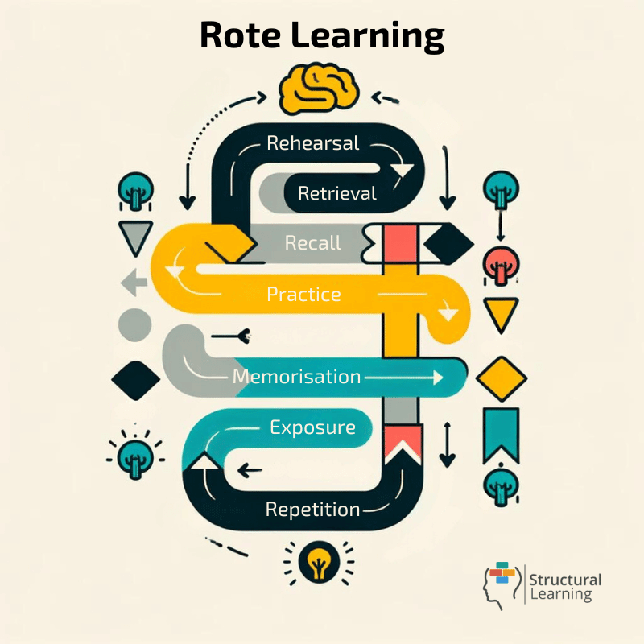
Rote Learning
Example:
A lookup table that stores multiplication results
A chatbot replying with pre-stored answers
Storing question–answer pairs in a database

Slide 13
Rote Learning
Advantages
Simple and easy to implement
Very fast response for known inputs
Requires no complex computation or training
Useful when exact recall is required
Predictable and consistent behavior
Disadvantages
No understanding or reasoning ability
Cannot handle new or unseen situations
No improvement over time
High memory usage for large datasets
Errors remain if incorrect information is memorized

Slide 14
Learning by Taking Advice
Learning by taking advice is a method where an AI system learns directly from instructions or guidance provided by a human expert or another system.
The advice is usually given in the form of rules, hints, constraints, or strategies.
This method reduces the need for large training data and speeds up learning.
The system’s performance strongly depends on the quality and correctness of the advice.
Model/Technique: Rule-Based Systems, Expert Systems, Production Systems (IF–THEN Rules)

Slide 15
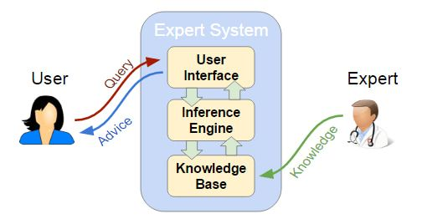
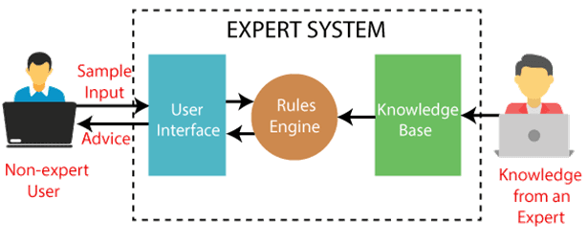
Learning by Taking Advice
Example: Learning by Taking Advice, where expert knowledge guides system behavior.
Example: A medical diagnosis system using doctor-defined rules

Slide 16
Learning by Taking Advice
Limitations of Learning by Taking Advice
Strongly depends on the quality of expert advice
Difficult to acquire and update expert knowledge
Limited adaptability to new or unseen situations
Not suitable for highly dynamic or uncertain environments
May fail if rules are incomplete or incorrect
Advantages of Learning by Taking Advice
Reduces the need for large training datasets
Faster learning using expert knowledge
Produces reliable results in well-defined domains
Easy to understand and explain decisions
Suitable for critical applications (medical, legal, industrial)

Slide 17
Learning in Problem Solving
Learning in problem solving occurs when an AI system improves its performance while solving problems.
The system learns from past successes and failures and refines its strategies over time.
It focuses on improving search efficiency, heuristics, and decision strategies.
This type of learning is commonly used in planning, game playing, and optimization tasks.
Model/Technique: Heuristic Search, A* Algorithm, Reinforcement Learning, Game-Playing Algorithms

Slide 18
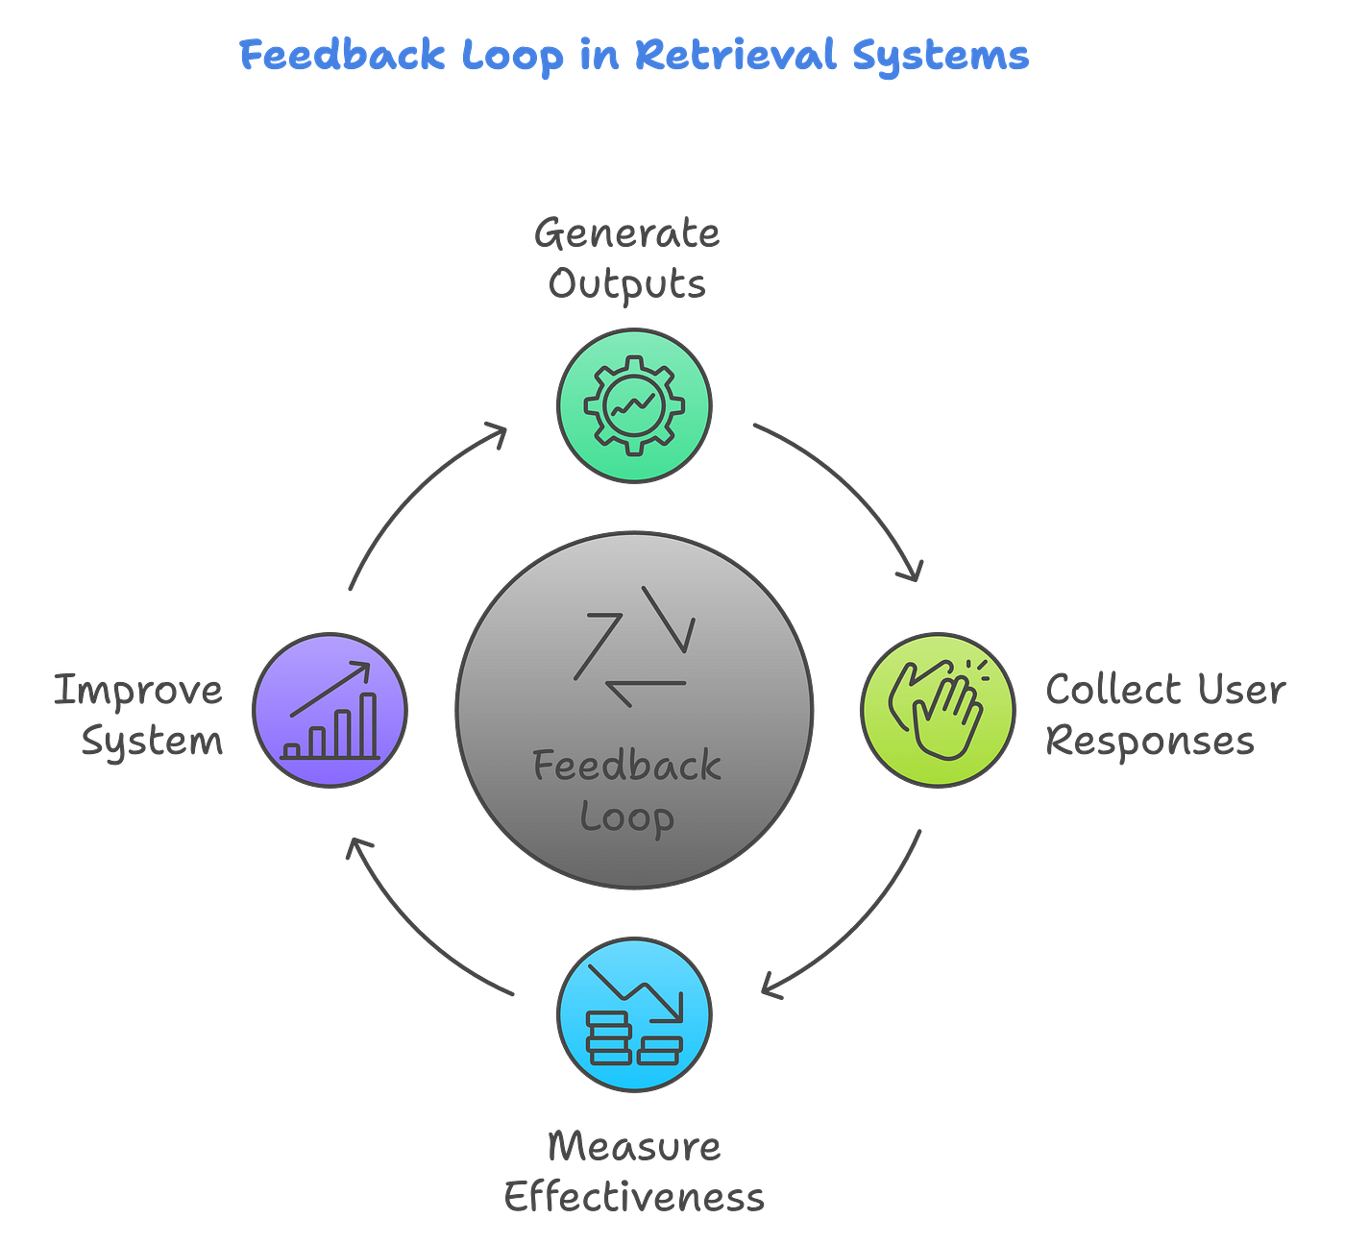
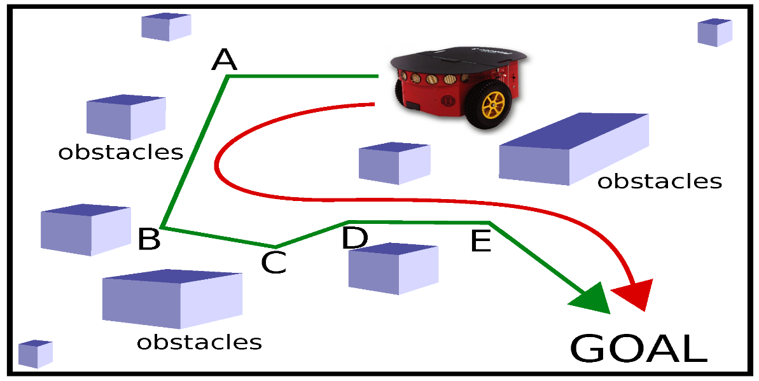
Learning in Problem Solving
Example
A chess-playing AI learns better moves by analyzing previously played games.
A path-finding robot improves its route selection based on earlier navigation experiences.
Puzzle-solving systems (e.g., 8-puzzle) learn better heuristics to reduce search time.

Slide 19
Learning in Problem Solving
Advantages
Improves efficiency and solution quality over time
Reduces computational cost by learning better strategies
Useful in sequential and decision-making problems
Limitations
Learning can be slow for complex problems
Requires repeated problem-solving experiences
Performance depends on the quality of feedback

Slide 20
Learning from Examples (Inductive Learning)
Inductive learning is a method where an AI system learns general rules or models from specific examples.
The system observes input–output pairs and infers patterns that can be applied to new, unseen data.
It focuses on generalization, not memorization.
This is one of the most widely used learning methods in machine learning.
Model/Technique: Decision Trees, Neural Networks, Random Forests

Slide 21
Learning from Examples (Inductive Learning)
Example
A spam detection system learns to classify emails as spam or not spam from labeled email examples.
A face recognition system learns facial patterns from sample images.
A handwritten digit recognition system learns from labeled digit images.

Slide 22
Learning from Examples (Inductive Learning)
Advantages
Capable of generalizing to unseen data
Works well with large datasets
Forms the foundation of modern machine learning systems
Limitations
Requires a sufficient amount of labeled data
Can overfit if training data is poor
Performance depends on data quality and feature selection

Slide 23
Explanation-Based Learning (EBL)
Explanation-Based Learning is a method where an AI system learns from one or a few examples by using prior domain knowledge.
The system first explains why an example works using existing knowledge and then generalizes this explanation into a rule.
It focuses on understanding the reason behind correctness, not just pattern matching.
EBL is useful when data is limited but strong background knowledge is available.
Model/Technique: Logic-Based Learning, Deductive Rule Learning, Knowledge-Based Systems

Slide 24
Explanation-Based Learning (EBL)
Example
A robot learning how to stack blocks correctly by reasoning about physics rules.
A medical diagnosis system learning a rule from a single correctly diagnosed case using medical knowledge.
A theorem-proving system learning general proof strategies from solved problems.
Difference between Inductive Learning and Explanation-Based Learning
Inductive Learning:
“I have seen many examples, so I learned the pattern.”
Explanation-Based Learning:
“I understood why this example works, so I can apply it generally.”

Slide 25
Explanation-Based Learning (EBL)
Advantages
Learns effectively from very few examples
Produces clear, interpretable rules
Uses domain knowledge to improve learning quality
Limitations
Strongly depends on accurate prior knowledge
Not suitable when domain knowledge is incomplete
Less effective in noisy or uncertain environments

Slide 26
Comparison of Learning Methods
Statistical Learning: Data-driven
Rote Learning: Memory-driven
Advice-Based Learning: Expert-driven
Inductive Learning: Example-driven
Explanation-Based Learning: Knowledge-driven

Slide 27
When to Use Each Method
Use statistical learning for big data
Use rote learning for repeated tasks
Use advice-based learning for domain knowledge
Use induction for predictive modeling
Use EBL for interpretable rule generation

Slide 28
Discussion Questions
Which learning method is most scalable?
Can multiple learning methods be combined?
How do modern AI systems integrate learning paradigms?

Slide 29
Class Activity
Divide into groups
Analyze real-world applications of learning methods
Present findings

Slide 30
Summary
Learning methods form the foundation of AI
Different methods serve different purposes
Combining methods often improves performance

Slide 31
Thank You
Questions and Discussion

